Slide 1

An Overview of C++
C H A P T E R 1
Out of these various experiments come programs. This is our experience: programs do not come out of the minds of one person or two people such as ourselves, but out of day‑to‑day work.
—Stokely Carmichael and Charles V. Hamilton, Black Power, 1967
1.1 The history of C++
1.2 The compilation process
1.3 Your first C++ program
1.4 The structure of a C++ program
1.5 Variables
1.6 Data types
1.7 Expressions
1.8 Statements

Slide 2
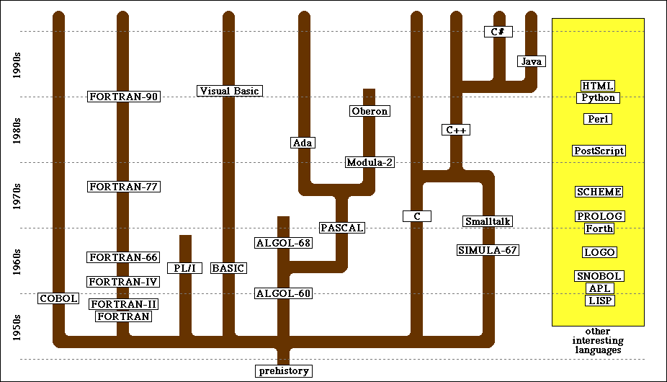
The History of C++

Slide 3
C++ Versions
The C++ programming language was developed by Bjarne Stroustrup at Bell Labs since 1979, as an extension of the C language as he wanted an efficient and flexible language similar to C, which also provided high-level features for program organization.
C++ was initially standardized in 1998 by the International Organization for Standardization (ISO) as C++98, which was then amended by the C++03, C++11 and C++14 standards.
The current C++17 standard supersedes these with new features and an enlarged standard library.
C++20 is the next planned standard thereafter, keeping with the current streak of a new version every three years.

Slide 4
Compiler vs. Interpreter
Compiler and Interpreter are two different ways to execute a program written in a programming or scripting language.
A compiler takes entire program and converts it into object code which is typically stored in a file. The object code is also refereed as binary code and can be directly executed by the machine after linking. Examples of compiled programming languages are C and C++.
An interpreter directly executes instructions written in a programming or scripting language without previously converting them to an object code or machine code. Examples of interpreted languages are Python and Matlab.

Slide 5
Compiler vs. Interpreter
Both compilers and interpreters covert source code (text files) into tokens. The basic difference is that a compiler system, including a (built in or separate) linker, generates a stand alone machine code program, while an interpreter system instead performs the actions described by the high level program.
Once a program is compiled, its source code is not useful for running the code. For interpreted programs, the source code is needed to run the program every time.
In general, interpreted programs run slower than the compiled programs.
Java programs are first compiled to an intermediate form, then interpreted by the interpreter.

Slide 6
The Compilation Process
source file
object file
/*
* File: HelloWorld.cpp
* --------------------
* This file is adapted from
* Kernighan and Ritchie's book
* The C Programming Language.
*/
#include <iostream>
using namespace std;
int main() {
cout << "hello, world" << endl;
return 0;
}
110100110111001011101110001110011
111000000100001110000001101111100
100010101110100100010001100110111
110001001010111010010110110001011
101101111101110111111011001101101
111001110001111111010001111100011
111100111110101111011101000011110
110111010000111111010100111001011
101111011111010111011111101000101
110111100110111010000111000111110
101010000111100111001010001001101
101101011101110111010111100010011
111111111100111111001001110110110
110101110011111100011010100100001
compiler
executable file
110100110111001011101110001110011
111000000100001110000001101111100
100010101110100100010001100110111
110001001010111010010110110001011
101101111101110111111011001101101
111001110001111111010001111100011
111100111110101111011101000011110
110111010000111111010100111001011
101111011111010111011111101000101
110111100110111010000111000111110
101010000111100111001010001001101
101101011101110111010111100010011
111111111100111111001001110110110
110101110011111100011010100100001
110100110111001011101110001110011
111000000100001110000001101111100
100010101110100100010001100110111
110001001010111010010110110001011
101101111101110111111011001101101
111001110001111111010001111100011
111100111110101111011101000011110
110111010000111111010100111001011
101111011111010111011111101000101
linker
library file
110100110111001011101110001110011
111000000100001110000001101111100
100010101110100100010001100110111
110001001010111010010110110001011
101101111101110111111011001101101
111001110001111111010001111100011
111100111110101111011101000011110
110111010000111111010100111001011
101111011111010111011111101000101
110111100110111010000111000111110
101010000111100111001010001001101
101101011101110111010111100010011
111111111100111111001001110110110
110101110011111100011010100100001

Slide 7
IDE & Compiler
IDE (Integrated Development Environment): A software that provides comprehensive facilities to computer programmers for software development, and normally consists of
a source code editor, which sometimes containing,
a class browser, an object browser, and a class hierarchy diagram, for use in object-oriented software development
GUI (Graphical User Interface) construction tools
a version control system
build automation tools (must at least contain a compiler or an interpreter, or both, sometimes a linker too)
a debugger
All these components may be from a third party.

Slide 8
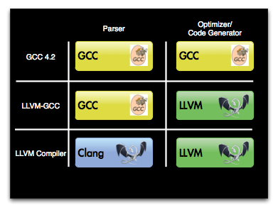

IDE & Compiler
IDEs, e.g.,
Qt Creater
Microsoft Visual Studio
Apple Xcode
Code::Blocks
Compilers, e.g.,
Microsoft Visual C++ compiler
GCC (GNU Compiler Collection)
MinGW (Minimalist GNU for Windows)
GUI and additional libraries support, e.g.,
Qt
MFC (Microsoft Foundation Classes)
StanfordCPPLib (from the textbook)
OpenCV (Open source computer vision libraries)

Slide 9
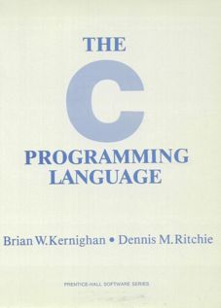
The “Hello World” Program
The C++ programming language is an extension of the C language, which was developed at Bell Labs in the early 1970s. The primary reference manual for C was written by Brian Kernighan and Dennis Ritchie.
On the first page of their book, the authors suggest that the best way to begin learning a new programming language is to write a simple program that prints the message “hello, world” on the display. That advice remains sound today.
1.1 Getting Started
The only way to learn a new programming language is to write programs in it. The first program to write is the same for all languages:
Print the words
hello, world
This is the big hurdle; to leap over it you have to be able to create the program text somewhere, compile it, load it, run it, and find out where your output went. With these mechanical details mastered, everything else is comparatively easy.
In C, the program to print “hello, world” is
#include <stdio.h>
main() {
printf(“hello, world\n”);
}

Slide 10



The “Hello World” Program in C++
/*
* File: HelloWorld.cpp
* --------------------
* This file is adapted from the example
* on page 1 of Kernighan and Ritchie's
* book The C Programming Language.
*/
#include <iostream>
using namespace std;
int main() {
cout << "hello, world" << endl;
return 0;
}
comments
library inclusions
main program
Notes:
Show helloworld.cpp

Slide 11
The Structure of a C++ Program
A comment is text that is ignored by the compiler but which nonetheless conveys information about the source code to other programmers (actually, to yourself too).
multi-line comments
/* Comments line 1
Comments line 2
Comments line 3 */
single-line comments
// Comments line 1
// Comments line 2
// Comments line 3
It is extremely important to write comments. Code tells you how, comments tell you why!

Slide 12
The Structure of a C++ Program
Libraries are collections of previously written tools that perform useful operations.
#include <iostream> instructs the compiler to read the relevant definitions from what is called a header (.h) file; for you own libraries, write #include “myownlib.h”
To ensure that the names defined in different parts of a large system do not interfere with one another, C++ segments code into structures called namespaces, each of which keeps track of its own set of names.
The standard C++ libraries use a namespace called std, which means that you cannot refer to the names defined in standard header files like iostream.h unless you let the compiler know to which namespace those definitions belong.

Slide 13
The Structure of a C++ Program
A function is a named section of code that performs a specific operation.
Every C++ program must contain a function with the name main. It specifies the starting point for the computation and is called when the program starts up. When main has finished its work and returns, execution of the program ends.
The main function can call other functions, e.g., raiseToPower in the PowerOfTwo program (next slide).
Although raiseToPower can be defined in the function definition part after the main function, a concise description of the raiseToPower function, called a function prototype, must appear before the main function.

Slide 14
The Structure of a C++ Program
/*
* Function: raiseToPower
* Usage: int p = raiseToPower(n, k);
* ----------------------------------
* Returns the integer n raised to the kth power.
*/
int raiseToPower(int n, int k) {
int result = 1;
for (int i = 0; i < k; i++) {
result *= n;
}
return result;
}
/*
* File: PowersOfTwo.cpp
* ---------------------
* This program generates a list of the powers of
* two up to an exponent limit entered by the user.
*/
#include <iostream>
using namespace std;
/* Function prototypes */
int raiseToPower(int n, int k);
/* Main program */
int main() {
int limit;
cout << "This program lists powers of two." << endl;
cout << "Enter exponent limit: ";
cin >> limit;
for (int i = 0; i <= limit; i++) {
cout << "2 to the " << i << " = "
<< raiseToPower(2, i) << endl;
}
return 0;
}
/*
* File: PowersOfTwo.cpp
* ---------------------
* This program generates a list of the powers of
* two up to an exponent limit entered by the user.
*/
#include <iostream>
using namespace std;
/* Function prototypes */
int raiseToPower(int n, int k);
/* Main program */
int main() {
int limit;
cout << "This program lists powers of two." << endl;
cout << "Enter exponent limit: ";
cin >> limit;
for (int i = 0; i <= limit; i++) {
cout << "2 to the " << i << " = "
<< raiseToPower(2, i) << endl;
}
return 0;
}
program comment
function comment
library inclusions
function definition
function prototype
main program

Slide 15
Question
Can we avoid using the function prototypes?

Slide 16
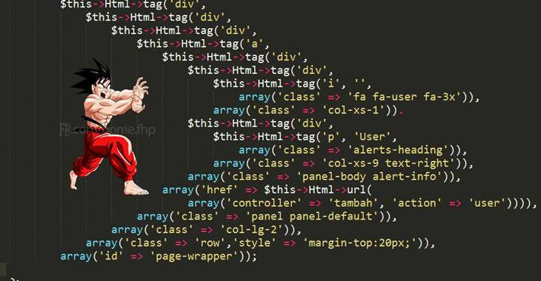
C++ Programming Style Guide
Style, also known as readability, is what we call the conventions that govern our C++ code. The term Style is a bit of a misnomer, since these conventions cover far more than just source file formatting.
Use common sense and be consistent.
https://google.github.io/styleguide/cppguide.html
Style matters!

Slide 17
Variables
A variable is a named address for storing a type of value.
In C++, you must declare a variable before you can use it. The declaration establishes the name and type of the variable and, in most cases, specifies the initial value as well.
The most common form of a variable declaration is where type is the name of a C++ primitive type or more complicated type such as class, name is an identifier that indicates the name of the variable, and value is an expression specifying the initial value.
Behind the declaration, what we a memory address is associated with the variable name, which we will discuss later in memory management.
type name = value;

Slide 18
Variables
A variable in C++ is most easily envisioned as a box capable of storing a value.
Each variable has the following attributes:
A name, which enables you to differentiate one variable from another.
A type, which specifies what type of value the variable can contain.
A value, which represents the current contents of the variable.
For now, let’s not worry about the address first.
The name and type of a variable are fixed. The value changes whenever you assign a new value to the variable.
total
42
(contains an int)

Slide 19
Question
What are the differences between Python variables and C++ variables?

Slide 20
Variables
Variable name is case sensitive.
Naming conventions (also a part of programming style)
The name must start with a letter or the underscore character (_).
All other characters in the name must be letters, digits, or the underscore. No spaces or other special characters are permitted in names.
Use meaningful words, but must not be one of the reserved keywords.

Slide 21
Variable Scope
In computer programming, the scope of a name binding – an association of a name to an entity, such as a variable – is the region of a computer program where the binding is valid: where the name can be used to refer to the entity.
Most declarations appear as statements in the body of a function definition. Variables declared in this way are called local variables and are accessible only inside that function.
Variables declared outside any function definition are global variables. Avoid global variables because they can be manipulated by any function in a program, and it is difficult to keep those functions from interfering with one another.
Variables may also be declared as part of a class. These are called instance variables and are covered in later chapters.

Slide 22
Constants
Unlike a variable, which is a placeholder for a value that can be updated as the program runs, the value of a constant does not change during the course of a program.
The format of a constant depends on its type:
Integral constants consist of a string of digits, optionally preceded by a minus sign, as in 0, 42, -1, or 1000000.
Floating-point constants include a decimal point, as in 3.14159265 or 10.0. Floating-point constants can also be expressed in scientific notation by adding the letter E and an exponent after the digits of the number, so that 5.646E-8 represents the number 5.646 x 10⁻⁸.
The two constants of type boolean are true and false.
Character and string constants are discussed in detail in later lectures. For the moment, all you need to know is that a string constant consists of a sequence of characters enclosed in double quotation marks, such as "hello, world".

Slide 23
Constants
If you use the same constant many times in a program, it would be better if you could give this constant a name and then refer to it by that name everywhere in the program.
You can declare it as a global constant, using reserved keyword const
const double PI = 3.14159265358979323846;

Slide 24
Data Types
A data type is defined by a domain, which is the set of values that belong to that type, and a set of operations, which defines the behavior of that type.
Although many data types are represented using objects or other compound structures, C++ defines a set of primitive types to represent simple data.
Of all the primitive types available in C++, the programs in this text typically use only the following four:
int
This type is used to represent integers, which are whole numbers such as 17 or –53.
double
This type is used to represent numbers that include a decimal fraction, such as 3.14159265.
bool
This type represents a logical value (true or false).
char
This type represents a single ASCII character.

Slide 25
Expressions
/*
* File: AddThreeNumbers.cpp
* -------------------------
* This program adds three floating-point numbers and prints their sum.
*/
#include <iostream>
using namespace std;
int main() {
double n1, n2, n3;
cout << "This program adds three numbers." << endl;
cout << "1st number: ";
cin >> n1;
cout << "2nd number: ";
cin >> n2;
cout << "3rd number: ";
cin >> n3;
double sum = n1 + n2 + n3;
cout << "The sum is " << sum << endl;
return 0;
}

Slide 26
Expressions
The heart of the AddThreeNumbers program is the line that performs the actual addition.
The n1 + n2 + n3 that appears to the right of the equal sign is an example of an expression, which specifies the operations involved in the computation.
An expression in C++ consists of terms joined together by operators.
Each term must be one of the following:
A constant (such as 3.14159265 or "hello, world")
A constant/variable name (such as PI, n1, n2, or total)
A function call that returns a value (such as readInt)
An expression enclosed in parentheses (“recursion”)
double sum = n1 + n2 + n3;

Slide 27
Operators and Operands
As in most languages, C++ programs specify computation in the form of arithmetic expressions that closely resemble expressions in mathematics.
The most common operators in C++ are the ones that specify arithmetic computation:
Operators in C++ usually appear between two sub-expressions, which are called its operands. Operators that take two operands are called binary operators.
The - operator can also appear as a unary operator, as in the expression -x, which denotes the negative of x.
+
Addition
*
Multiplication
–
Subtraction
/
Division
%
Remainder

Slide 28

Division and Type Casts
In C++, whenever you apply a binary operator to numeric values, the result will be of type int if both operands are of type int, but will be a double if either operand is a double.
This rule has important consequences in the case of division. For example, the expression
14 / 5
seems as if it should have the value 2.8, but because both operands are of type int, C++ computes an integer result by throwing away the fractional part. The result is therefore 2.
If you want to obtain the mathematically correct result, you need to convert at least one operand to a double, as in
double(14 / 5)
The conversion is accomplished by means of a type cast, which you specify by using the type name as a function call.

Slide 29
Exercise: The Pitfalls of Integer Division
Consider the following C++ statements, which are intended to convert 100˚ Celsius temperature to its Fahrenheit equivalent:
double c = 100;
double f = 9 / 5 * c + 32;
The computation consists of evaluating the following expression:
9 / 5 * c + 32
The problem arises from the fact that both 9 and 5 are of type int, which means that the result is also an int.
132
100
1
9 / 5 * c + 32

Slide 30
The Pitfalls of Integer Division
You can fix this problem by converting the fraction to a double, either by inserting decimal points or by using a type cast:
double c = 100;
double f = double(9) / 5 * c + 32;
The computation now looks like this:
212.0
180.0
1.8
9.0
double(9) / 5 * c + 32

Slide 31
The Remainder Operator
The only arithmetic operator that has no direct mathematical counterpart is %, which applies only to integer operands and computes the remainder when the first divided by the second:
14 % 5
returns
4
14 % 7
returns
0
7 % 14
returns
7
The result of the % operator make intuitive sense only if both operands are positive. The examples in the book do not depend on knowing how % works with negative numbers.
The remainder operator turns out to be useful in a surprising number of programming applications and is well worth a bit of study.

Slide 32
Precedence
If an expression contains more than one operator, C++ uses precedence rules to determine the order of evaluation. The arithmetic operators have the following relative precedence:
unary -
highest
* / %
+ -
lowest
Thus, C++ evaluates any unary – operators first, followed by the operators *, /, and %, and finally the operators + and -.
Precedence applies only when two operands compete for the same operator. If the operators are independent, C++ evaluates expressions from left to right.
Parentheses may be used to change the order of operations.

Slide 33
Exercise: Precedence Evaluation
What is the value of the expression at the bottom of the screen?
42
32
0
32
0
4
3
30
8
(
1
+
2
)
%
3
*
4
+
5
*
6
/
7
*
(
8
%
9
)
+
10

Slide 34
Assignment Statements
You can change the value of a variable in your program by using an assignment statement, which has the general form:
variable = expression;
The effect of an assignment statement is to compute the value of the expression on the right side of the equal sign and assign that value to the variable that appears on the left. Thus, the assignment statement
total = total + value;
adds together the current values of the variables total and value and then stores that sum back in the variable total.
When you assign a new value to a variable, the old value of that variable is lost.

Slide 35
Shorthand Assignments
Statements such as
total = total + value;
are so common that C++ allows the following shorthand form:
total += value;
The general form of a shorthand assignment is
variable op= expression;
where op is any of C++’s binary operators. The effect of this statement is the same as
variable = variable op (expression);
For example, the following statement multiplies salary by 2.
salary *= 2;

Slide 36

Question
L-value: has an address, can appear on both sides of assignments.
R-value: no address, cannot appear on the left side of assignments.

Slide 37
Increment and Decrement Operators
Another important shorthand form that appears frequently in C++ programs is the increment operator, which is most commonly written immediately after a variable, like this:
x++; ++x;
The effect of this statement is to add one to the value of x, which means that this statement is equivalent to
x += 1;
or in an even longer form
x = x + 1;
The -- operator (which is called the decrement operator) is similar but subtracts one instead of adding one.
The ++ and -- operators are more complicated than shown here, but it makes sense to defer the details until later.

Slide 38
Boolean Expressions
The operators used with the boolean data type fall into two categories: relational operators and logical operators.
There are six relational operators that compare values of other types and produce a boolean result:
= =
Equals
!=
Not equals
<
Less than
<=
Less than or equal to
>
Greater than
>=
Greater than or equal to
For example, the expression n <= 10 has the value true if n is less than or equal to 10 and the value false otherwise.
There are also three logical operators:
&&
Logical AND
p && q means both p and q
||
Logical OR
p || q means either p or q (or both)
!
Logical NOT
!p means the opposite of p

Slide 39
Notes on the Boolean Operators
Remember that C++ uses = to denote assignment. To test whether two values are equal, you must use the = = operator.
It is not legal in C++ to use more than one relational operator in a single comparison as is often done in mathematics. To express the idea embodied in the mathematical expression
0 ≤ x ≤ 9
you need to make both comparisons explicit, as in
0 <= x && x <= 9
The || operator means either or both, which is not always clear in the English interpretation of or.
Be careful when you combine the ! operator with && and || because the interpretation often differs from informal English.

Slide 40
Short-Circuit Evaluation
C++ evaluates the && and || operators using a strategy called short-circuit mode in which it evaluates the right operand only if it needs to do so.
For example, if n is 0, the right hand operand of && in
n != 0 && x % n == 0
is not evaluated at all because n != 0 is false. Because the expression
false && anything
is always false, the rest of the expression no longer matters.
One of the advantages of short-circuit evaluation is that you can use && and || to prevent execution errors. If n were 0 in the earlier example, evaluating x % n would cause a “division by zero” error.

Slide 41
Statements
Statements in C++ fall into three basic types:
Simple statements
Compound statements
Control statements
Simple statements are formed by adding a semicolon to the end of a C++ expression.
Compound statements (also called blocks) are sequences of statements enclosed in curly braces.
Control statements fall into two categories:
Conditional statements that specify some kind of test
Iterative statements that specify repetition

Slide 42
The if Statement
The simplest of the control statements is the if statement, which occurs in two forms. You use the first form whenever you need to perform an operation only if a particular condition is true:
if (condition) {
statements to be executed if the condition is true
}
You use the second form whenever you want to choose between two alternative paths, one for cases in which a condition is true and a second for cases in which that condition is false:
if (condition) {
statements to be executed if the condition is true
} else {
statements to be executed if the condition is false
}

Slide 43
Common Forms of the if Statement
The examples in the book use only the following forms of the if statement:
Single line if statement
Multiline if statement with curly braces
if (condition) statement
if (condition) {
statement
. . . more statements . . .
}
if/else statement with curly braces
Cascading if statement
if (condition) {
statements_{true}
} else {
statements_{false}
}
if (condition₁) {
statements₁
} else if (condition₂) {
statements₂
. . . more else/if conditions . . .
} else {
statements_{else}
}

Slide 44
The ?: Operator
In addition to the if statement, C++ provides a more compact way to express conditional execution that can be extremely useful in certain situations. This feature is called the ?: operator (pronounced question-mark-colon) and is part of the expression structure. The ?: operator has the following form:
condition ? expression₁ : expression₂
When C++ evaluates the ?: operator, it first determines the value of condition. If condition is true, C++ evaluates expression₁ and uses that as the value; if condition is false, C++ evaluates expression₂ instead.
You can use the ?: operator to assign the larger of x and y to the variable max like this:
max = (x > y) ? x : y;

Slide 45
The switch Statement
The switch statement provides a convenient syntax for choosing among a set of possible paths:
When C++ executes a switch statement, it begins by evaluating expression, which must produce an integer-like value.
C++ then looks for a case clause that matches expression. If expression was equal to v₂, C++ would choose the second clause.
C++ evaluates the statements in a case clause until it reaches the break statement, which should appear at the end of each clause.
If none of the values in the case clauses match the expression, C++ evaluates the statements in the default clause.
The switch statement provides a convenient syntax for choosing among a set of possible paths:
switch ( expression ) {
case v₁:
statements to be executed if expression = v₁
break;
case v₂:
statements to be executed if expression = v₂
break;
. . . more case clauses if needed . . .
default:
statements to be executed if no values match
break;
}
switch ( expression ) {
case v₁:
statements to be executed if expression = v₁
break;
case v₂:
statements to be executed if expression = v₂
break;
. . . more case clauses if needed . . .
default:
statements to be executed if no values match
break;
}

Slide 46
Example of the switch Statement
int main() {
int month;
cout << "Enter numeric month (Jan=1): ";
cin >> month;
switch (month) {
case 2:
cout << "28 days (29 in leap years)" << endl;
break;
case 4: case 6: case 9: case 11:
cout << "30 days" << endl;
break;
case 1: case 3: case 5: case 7: case 8: case 12:
cout << "31 days" << endl;
break;
default:
cout << "Illegal month number" << endl;
break;
}
return 0;
}

Slide 47
The while Statement
The while statement is the simplest of C++’s iterative control statements and has the following form:
while ( condition ) {
statements to be repeated
}
while ( condition ) {
statements to be repeated
}
When C++ encounters a while statement, it begins by evaluating the condition in parentheses.
If the value of condition is true, C++ executes the statements in the body of the loop.
At the end of each cycle, C++ reevaluates condition to see whether its value has changed. If condition evaluates to false, C++ exits from the loop and continues with the statement following the closing brace at the end of the while body.

Slide 48
The for Statement
The for statement in C++ is a particularly powerful tool for specifying the control structure of a loop independently from the operations the loop body performs. The syntax looks like this:
for ( init ; test ; step ) {
statements to be repeated
}
for ( init ; test ; step ) {
statements to be repeated
}
C++ evaluates a for statement by executing the following steps:
1.
Evaluate init, which typically declares a control variable.
2.
Evaluate test and exit from the loop if the value is false.
3.
Execute the statements in the body of the loop.
4.
Evaluate step, which usually updates the control variable.
5.
Return to step 2 to begin the next loop cycle.

Slide 49
Comparing for and while
The for statement
for ( init ; test ; step ) {
statements to be repeated
}
is functionally equivalent to the following code using while:
init;
while ( test ) {
statements to be repeated
step;
}
The advantage of the for statement is that everything you need to know to understand how many times the loop will run is explicitly included in the header line.

Slide 50
Exercise: Reading for Statements
Describe the effect of each of the following for statements:
1.
for (int i = 1; i <= 10; i++)
This statement executes the loop body 10 times, with the control variable i taking on each successive value between 1 and 10.
2.
for (int i = 0; i < N; i++)
This statement executes the loop body N times, with i counting from 0 to N - 1. This version is the standard Repeat-N-Times idiom.
3.
for (int n = 99; n >= 1; n -= 2)
This statement counts backward from 99 to 1 by 2’s, for 50 times.
4.
for (int x = 1; x <= 1024; x *= 2)
This statement executes the loop body with the variable x taking on successive powers of 2 from 1 up to 1024, for 11 times.

Slide 51
The End

